Slide 1
Deep Learning
© 2025 Virginia Polytechnic Institute and State University. All rights reserved.

Slide 2
At the end of this module, you should be able to:
Describe the general ideas behind neural networks
Describe situations in which neural networks would be useful
Describe the general procedures for Convolution Neural Networks (CNN), Recurrent Neural Networks (RNN), Gradient Descent, Back Propagation, and Dropout Learning
Implement basic neural network Python

Slide 3
Deep Learning

Slide 4
Introduction to Machine Learning Course Roadmap
What is the goal of the data analysis?
Predict an output |  |  |  |  |  | Reveal patterns or relationships |  | Make decisions using an autonomous agent
Supervised Learning (Output in the data set) |  |  |  |  |  | Unsupervised Learning (No output in the data set) |  | Reinforcement Learning* (Supervised & unsupervised)
Continuous or discrete output? |  |  |  |  |  | What is the subgoal? |  | Does a model exist?
Continuous |  |  | Discrete |  |  | Identify groups | Reduce dimensions | Model Based | Model Free
Simple linear regression Multiple linear regression Subset selection Ridge regression & LASSO PCR & PLS | Polynomial regression Step functions Splines Local regression General additive models | Decision tree Random forest Neural network Gradient boosting tree | Logistic regression Linear discriminant analysis Quadratic discriminant analysis | Decision tree Random forest Neural network Gradient boosting tree | Support vector machines | Hierarchical clustering K-means clustering | Principal components analysis | Given the model Learn the model | Policy Optimization Q-Learning
Neural network
Neural network
*Advanced Topic: Bonus module if time
Notes:
Neural networks are a very flexible technique that can be used in supervised learning with both continuous and discrete responses. They can also be used in the unsupervised learning context. This means they can be useful when we have data with outputs that we may want to predict or classify, or when we do not have outputs and simply want to determine patterns and relationships in data.
This module will focus on a conceptual understanding of neural networks in the supervised learning context but the ideas can be extended to the unsupervised learning context.

Slide 5
Supervised versus unsupervised again
Some tangible measurement(s)
“The Black Box”
INPUTS
MACHINE LEARNING MODEL
OUTPUT(S)
Supervised Learning
In the context of domain knowledge
“The Black Box”
INPUTS
MACHINE LEARNING MODEL
PATTERNS,
RELATIONSHIPS, STRUCTURE
Unsupervised Learning
does it make sense?
Notes:
As we suggested on the last slide, neural networks can be used in both supervised and unsupervised learning.

Slide 6
Supervised learning method selection is based on the response type
Is my response quantitative or qualitative?
Age
Height
Income
Stock Price
Tensile Strength
Quantitative
Qualitative
Blood Type
Default on Debt (y/n)
Cancer Stage
Brand Purchased
Species
Typically use regression method
Typically use classification method
Discrete: Nominal or Ordinal
Continuous Measures
What about the predictors?
For most methods, predictors can be
either quantitative or qualitative.
Notes:
As we suggested on the earlier slide, neural networks can be used in both the regression and classification framework.

Slide 7
Two methods of estimation
Parametric
(Less Flexible, More Interpretable)
Non-parametric
(More Flexible, Less Interpretable)
Inference focused
Select a model which involves an assumption about the functional form of f. Train the model and estimate parameters.
Example:
f is linear in X: f(X) = β₀+β₁X₁ + β₂X₂ +…+ β_{p}X_{p}
Prediction focused
Does not make explicit assumptions about the functional form of f. Can fit wider range of possible shapes for f, but at that cost of needing a larger number of observations.
Example:
Tree-based methods
Notes:
There is some debate around neural networks and if they should be considered a parametric or non-parametric approach. The answer seems to lie around which type of neural network is being used. Simpler versions do have parameters that are tuned to get a final fit of the neural net, but often these parameters are not practically interpretable. Other more complicated neural networks do not have a strict functional form that we can understand.

Slide 8
Deep Learning

Slide 9


Motivation: When will we use neural networks?
Learning Complex Non-linear Relationships
Handling High-Dimensional Data

Slide 10
Overall flowchart for neural networks
Define the Problem
Prepare the Data
Choose the Neural Network Architecture
Initialize Weights
Evaluate the Model
Tune Hyperparameters
Validate the Model
Train the Model
Finalize the Model

Slide 11
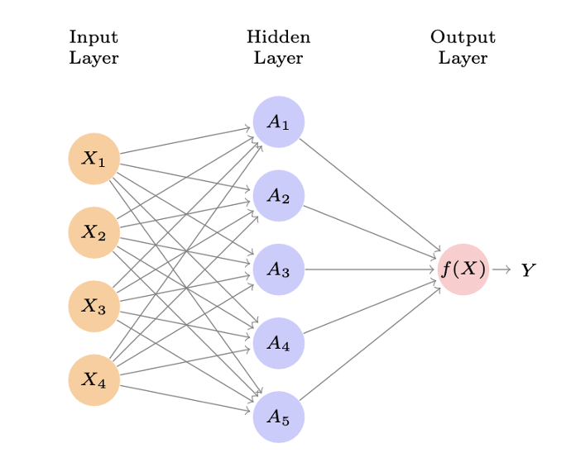
Single layer neural network

Slide 12
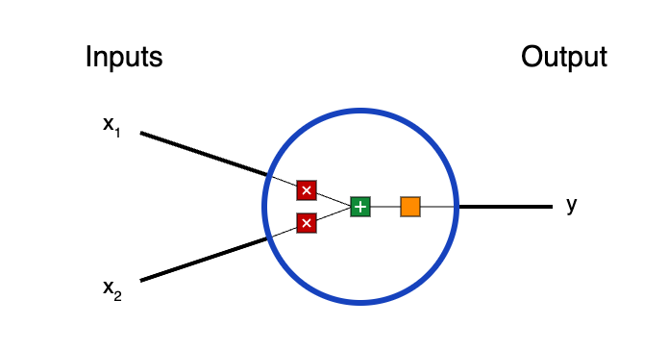
Building blocks: Neurons
weight
Activation function
bias

Slide 13
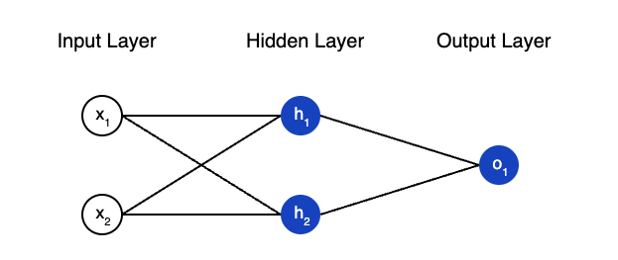
Combining neurons into a neural network

Slide 14
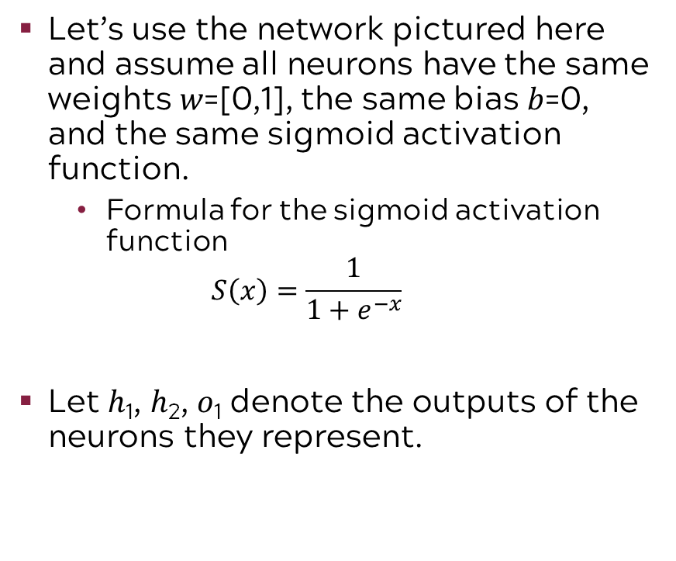
A simple example: Feedforward
Let’s use the network pictured here and assume all neurons have the same weights 𝑤=[0,1], the same bias 𝑏=0, and the same sigmoid activation function.
Formula for the sigmoid activation function
$$S\left(x\right)=\frac{1}{1+e^{−x}}$$
Let ℎ₁, ℎ₂, 𝑜₁ denote the outputs of the neurons they represent.

Slide 15
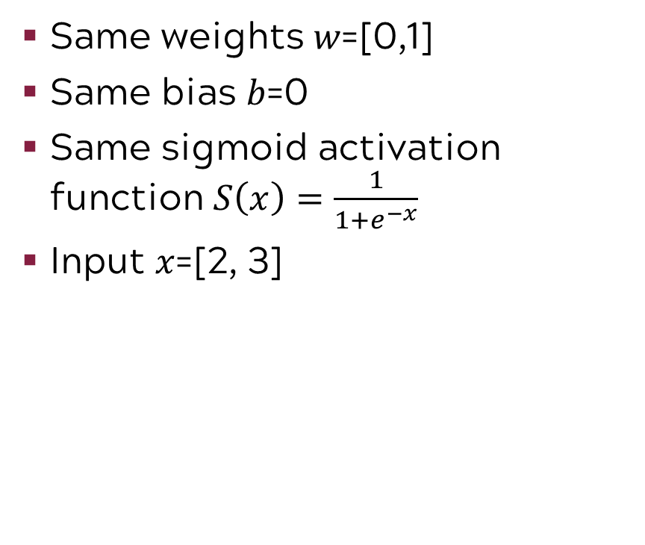
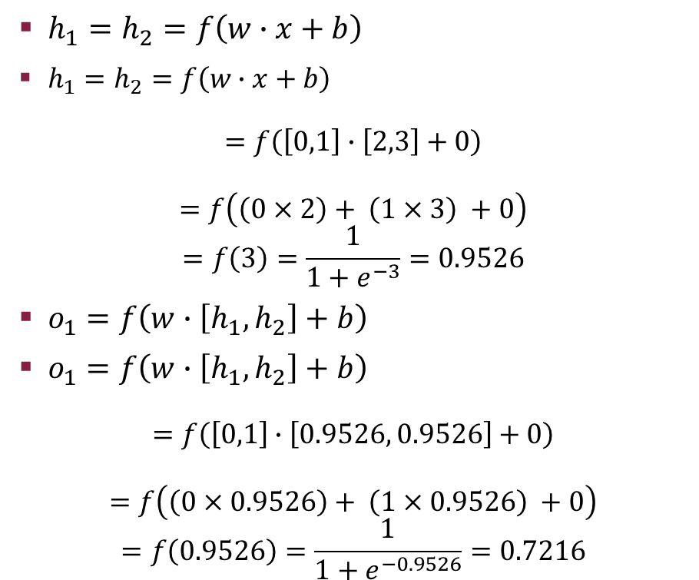
What happen if we pass in the input 𝑥=[2, 3]?
$h_{1}=h_{2}=f\left(w∙x+b\right)$
$h_{1}=h_{2}=f\left(w∙x+b\right)$
$$=f\left(\left[0,1\right]∙\left[2,3\right]+0\right)$$
$$=f\left(\left(0×2\right)+ \left(1×3\right) +0\right)$$
$$=f\left(3\right)=\frac{1}{1+e^{−3}}=0.9526$$
$o_{1}=f\left(w∙\left[h_{1}, h_{2}\right]+b\right)$
$o_{1}=f\left(w∙\left[h_{1}, h_{2}\right]+b\right)$
$$=f\left(\left[0,1\right]∙\left[0.9526, 0.9526\right]+0\right)$$
$$=f\left(\left(0×0.9526\right)+ \left(1×0.9526\right) +0\right)$$
$$=f\left(0.9526\right)=\frac{1}{1+e^{−0.9526}}=0.7216$$
Same weights 𝑤=[0,1]
Same bias 𝑏=0
Same sigmoid activation function $S\left(x\right)=\frac{1}{1+e^{−x}}$
Input 𝑥=[2, 3]

Slide 16
Input layer is responsible for receiving the raw input data
Raw input data could be in various forms such as images, text, or numerical data, and passing it to the next layers in the network.

Slide 17
Hidden layer applies a weighted sum and a bias to the inputs from the previous layer
By using the activation function, the hidden layer enables the network to learn complex patterns in the data.

Slide 18
Output layer receives the processed data from the last hidden layer
Output layer applies an activation function to generate the output, which could be class labels, probabilities, or continuous values, depending on the task.
Notes:
In general, a neural network takes an input vector of p variables X=(X1, …, Xp) and builds a nonlinear function f(X) to predict response Y.

Slide 19
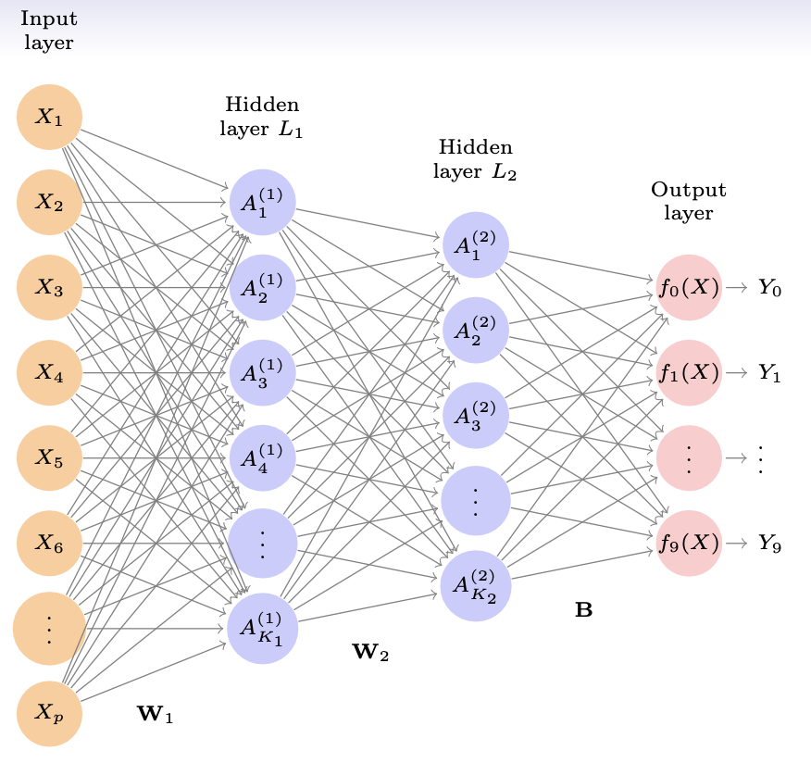
Multilayer Perceptron (MLP) is an expanded version of a simple neural network that has more than one hidden layer
Resource: http://playground.tensorflow.org

Slide 20
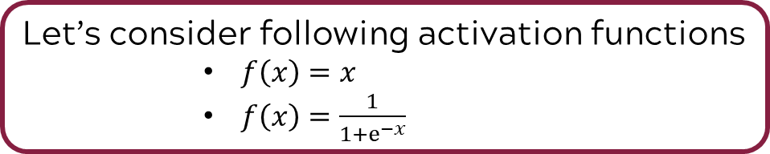
The simplest neural network?
weight
Activation function
bias
Let’s consider following activation functions
$f\left(x\right)=x$
$f\left(x\right)=\frac{1}{1+ⅇ^{−x}}$

Slide 21
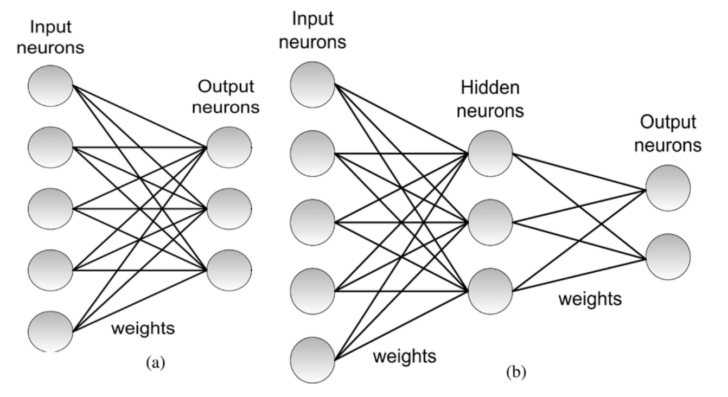
Single layer vs. multiple layer: What is the difference?
A single-layer model has only one processing layer that directly takes input and produces output. This approach is more straightforward and best suited for tasks where the data relationships are simple or well-separated.
A multi-layer model has multiple processing layers, each with its own weights and biases. These models are excel at complex, high-dimensional tasks where hierarchical and non-linear features need to be learned, making them foundational for most cutting-edge deep - learning applications.
Notes:
Single-Layer Model (e.g., Logistic Regression): Used for predicting a binary health outcome, like whether a patient has a particular disease based on a few test results. This model can work well if the health indicators are linearly related to the outcome and the task is straightforward.Multi-Layer Model (e.g., CNNs or RNNs): Used for analyzing complex medical imaging or predicting patient prognosis. Multi-layer models are applied to tasks like analyzing X-rays, MRI scans, or histopathology images to detect abnormalities with a high degree of accuracy. They also predict patient outcomes based on a combination of medical records, lifestyle data, and genetic information.

Slide 22
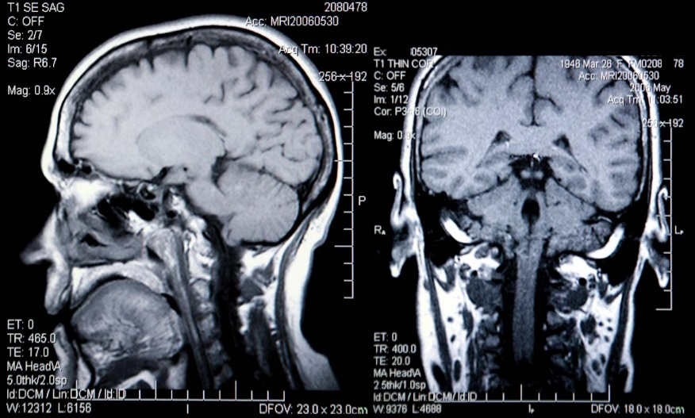
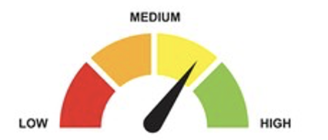
Example of differences in medical diagnostics (e.g., stroke risk assessment)
Single-Layer Model: Used for predicting a binary health outcome, like whether a patient has a particular disease based on a few test results. This model can work well if the health indicators are linearly related to the outcome and the task is straightforward.
Multi-Layer Model: Used for analyzing complex medical imaging or predicting patient prognosis. Multi-layer models are applied to tasks like analyzing X-rays, MRI scans, or histopathology images to detect abnormalities with a high degree of accuracy. They also predict patient outcomes based on a combination of medical records, lifestyle data, and genetic information.

Slide 23
Deep Learning

Slide 24
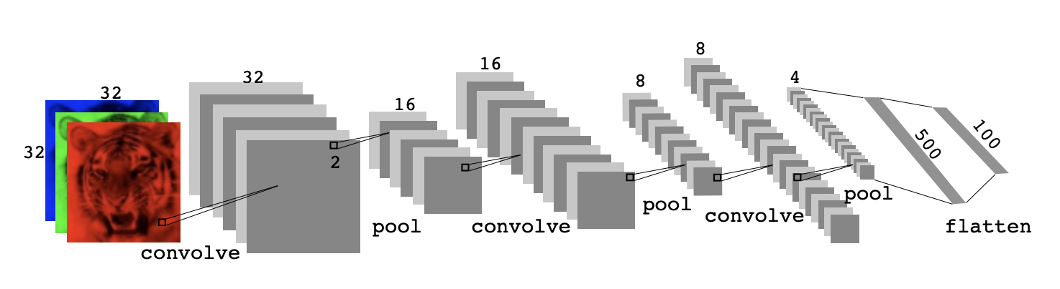
A Convolutional Neural Network (CNN) is a type of artificial neural network specifically designed for processing structured grid-like data, such as images
CNNs are widely used in image recognition, object detection, and other computer vision tasks.
Instead of processing the entire image at once, CNNs apply small filters (or kernels) to scan across the image.

Slide 25
Why are CNNs useful?
Great for Image Data: CNNs excel at understanding image data because they can automatically detect and learn important features, such as edges, shapes, textures, and patterns, at different levels.
Reduces Complexity: Unlike traditional neural networks, CNNs are designed to handle large image sizes by focusing on smaller sections (called "filters" or "kernels") of the image, making computations more efficient.
Fewer Parameters: CNNs use local connections and parameter sharing, which reduces the number of parameters and helps prevent overfitting.

Slide 26
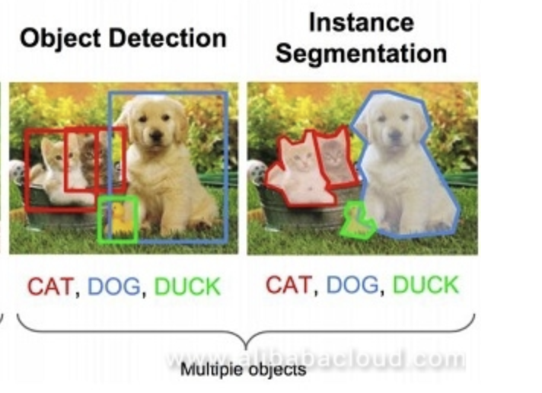

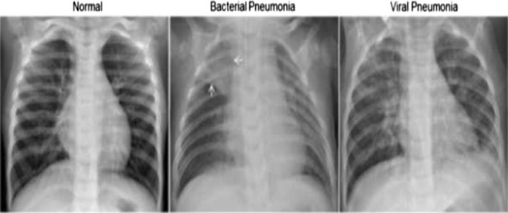
CNN Applications
Face recognition
Object detection
Medical imaging
Notes:
Deep convolutional neural network based medical image classification for disease diagnosis (https://journalofbigdata.springeropen.com/articles/10.1186/s40537-019-0276-2)
https://www.alibabacloud.com/blog/593829

Slide 27
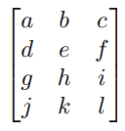
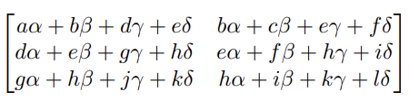
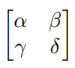
A convolution layer uses small filters (kernels) to extract features like edges, textures, and patterns from an input image or data
Convolution filter relies on a very simple operation, called a convolution.
Original Image:
4x3 matrix
Convolution Filter
2x2 matrix (kernel)
When we convolve the image with filter
output is a Feature Map

Slide 28
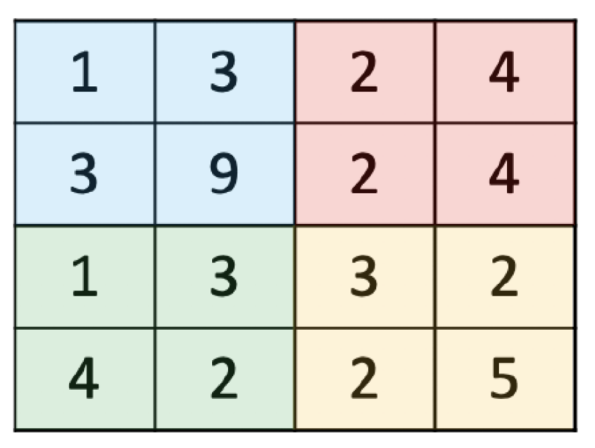
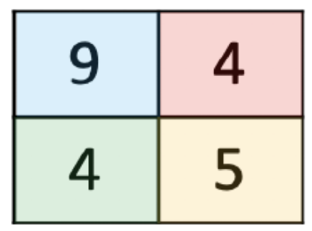
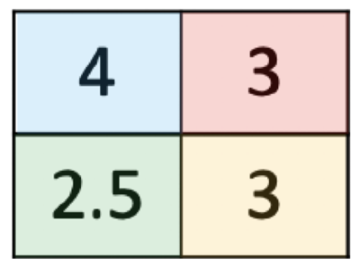
Pooling (subsampling) serves to simplify the data, reduce computational costs, prevent overfitting, and make the network more robust, while still retaining the essential information needed for accurate predictions.
Feature map
Max Pooling
Mean Pooling

Slide 29

Building the CNN architecture
Input Layer
Convolutional Layer
Pooling Layer
Repeat Convolution and Pooling
Fully Connected Layers
Output Layer
Flatten Layer

Slide 30
Input and first convolution layer
Input Image (32x32)
The input is a color image, represented by three layers (RGB channels) of size 32x32 pixels.
Convolution
The first layer applies convolution filters to extract features like edges and textures from the image.
This produces multiple feature maps (also 32x32 but with different filters).

Slide 31
Pooling layer and then repeating process of convolution and pooling
Pooling
After the convolution, a pooling layer reduces the size of the feature maps (e.g., from 32x32 to 16x16).
This keeps essential information while discarding unnecessary details.
More Convolution and Pooling
The process repeats, applying more convolution layers to extract deeper features and more pooling to
progressively reduce the feature map sizes (16x16 → 8x8 → 4x4).

Slide 32
Flattening at the end
Flattening
At the end, the feature maps are flattened into a 1D vector (of length 500), preparing the data to pass into the fully connected layers.

Slide 33
Deep Learning

Slide 34
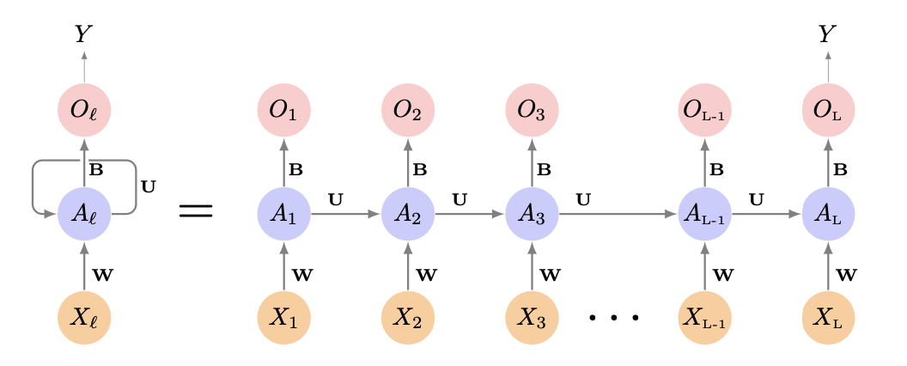
A Recurrent Neural Network (RNN) is a type of neural network that is designed to recognize patterns in sequences of data.
While traditional neural networks assume that all inputs (like images) are independent of each other, RNNs are specialized for data where the order matters, such as time series, text, or speech.

Slide 35
Why are RNNs useful?
Great for Sequential Data: RNNs excel at processing sequences like text, speech, or time series, capturing patterns that unfold over time.
Maintains Context: They "remember" previous inputs, making them ideal for tasks like language translation and time-dependent predictions.
Handles Variable Lengths: RNNs can process sequences of different lengths, perfect for text or speech, where input sizes vary.
Time-Dependent Predictions: RNNs are effective for tasks like forecasting or generating sequences where the current output depends on prior steps.

Slide 36



RNN applications
Netflix Recommendations
Autocorrect and Text Prediction
Stock Market
Prediction

Slide 37
Schematic of a simple RNN
Input: The input to this Recurrent Neural Network (RNN) is a sequence of vectors 𝑋_{𝑙}, where each 𝑋_{𝑙} represents an element in the sequence. These could be words in a sentence, time steps in time-series data, or individual data points in a sequential task.

Slide 38
Hidden Layer Processing: Each input 𝑋_{𝑙} and the previous hidden state 𝐴_{(𝑙−1)} are used to compute the current hidden state 𝐴_{𝑙}. This captures dependencies in the sequence.

Slide 39
Shared Weights: The same weights W (for input), U (for previous state), and B (bias) are used across all time steps, making the network efficient and generalizable.

Slide 40
Output: Each hidden state 𝐴_{𝑙} generates an output ​, but typically, only the last output 𝑂_{𝐿} is relevant for the final prediction
Recurrent Connection: The hidden state is passed along to the next time step, allowing the network to maintain a memory of the sequence as it processes further inputs.

Slide 41
Summary: NN, CNN, RNN
Attribute | Neural Networks (NN) | Convolutional Neural Networks (CNN) | Recurrent Neural Networks (RNN)
Purpose | General-purpose models for structured and unstructured data processing | Image and spatial data analysis | Sequential data and Time dependent predictions
Applications | Binary classification, basic predictive tasks | Object detection, medical imaging, face recognition | Language translation, stock price prediction, text generation
Why It’s Useful | Flexible and adaptable for a variety of problems Enables understanding non-linear relationships | Great for image data Reduces computational costs by focusing on key features | Great for sequential data Ideal for capturing temporal dependencies Useful for forecasting and natural language tasks

Slide 42
Deep Learning

Slide 43
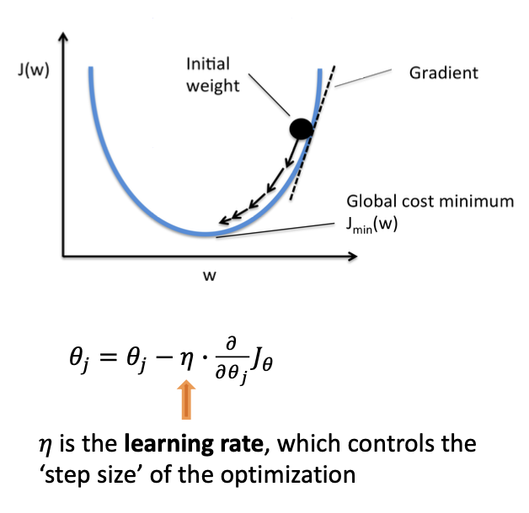
Gradient descent is an optimization algorithm
Gradient Descent is an optimization algorithm used to minimize the loss function (or error) in machine learning models. It helps the model learn by adjusting its parameters (like weights and biases) to reduce prediction errors.
The goal is to minimize the error (loss) between the predicted output and the actual output.
A gradient measures how much the output of a function changes if you change the inputs a little bit.
Notes:
Loss function may be Test MSE (regression) or Test Error, accuracy, entropy, etc. for classification

Slide 44
Backpropagation is a gradient estimation method
Backpropagation is a gradient estimation method commonly used for training neural networks to compute the network parameter updates.
Backpropagation tells the model how wrong it was by distributing the error backward through the network.
Gradient Descent uses this information to adjust the model’s weights, making it better at predicting. This process repeats until the model performs well on the data.
Notes:
https://neptune.ai/blog/backpropagation-algorithm-in-neural-networks-guide

Slide 45
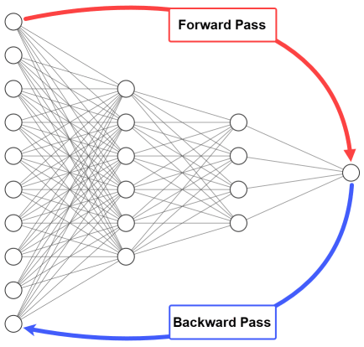
Backpropagation
Forward Pass
The input data goes through the network, layer by layer, to produce an output (prediction).
Calculate Error
The difference between the predicted output and the actual target value is calculated. This is called the loss or error.
Backward Pass
Backpropagation starts at the output layer and moves backward through the network, calculating how much each weight contributed to the error and how to adjust them to improve predictions.
Update Weights (with Gradient Descent)
The weights are updated using gradient descent, which moves the weights in a direction that reduces the error.
Notes:
https://neptune.ai/blog/backpropagation-algorithm-in-neural-networks-guide

Slide 46
Dropout learning is a regularization technique
Dropout learning is a regularization technique used in neural networks to prevent overfitting.
It works by randomly "dropping out” neurons during training.
Prevents overfitting: In a standard neural network, neurons can become highly dependent on specific other neurons, leading to overfitting, where the model performs well on training data but poorly on new, unseen data. Dropout forces the network to learn more robust features by ensuring that no one neuron or set of neurons can dominate the learning process.
Improves generalization: By training the network in a way where neurons are randomly excluded, dropout forces the network to adapt and learn more general patterns, rather than memorizing the training data.

Slide 47
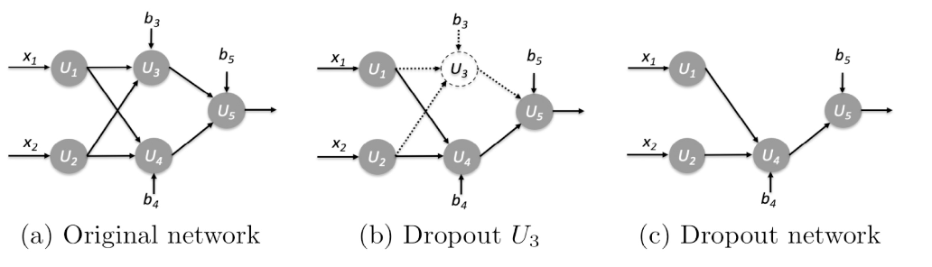
The dropout rate is the probability of dropping a neuron
A typical dropout rate is between 0.2 and 0.5.
For example, a dropout rate of 0.5 means half of the neurons in a layer will be randomly deactivated during each training iteration.

Slide 48
Exercise: Default data
Dataset: default from ISLP package​
Predict default status of customers on their credit card payment
Variables:
student: Indicates whether the customer is a student.
balance: The average balance on the customer’s credit card in USD.
income: The annual income of the customer in thousands of dollars.
default (Target): Indicates whether the customer defaulted on their credit card payment.

Slide 49
ML paradigm to evaluate model performance
Test Error: average error that results from using a machine learning method to predict the response on data that was not used in training the method
Models are built to do well on the data they’ve been fed. We want to ensure they also do well on data they haven’t encountered.
Whole Sample
Randomly
divide
Training set
Fit
Model
Prediction
Validation set
Tune
Test
Test Error
Test set
Notes:
Before we jump into the exercise, recall the ML paradigm to evaluate model performance with test error
A common way to evaluate its performance in this paradigm is through test error. The model is used to make predictions on the test set, which the model has not yet “seen”, and from these predictions we can get test error. Test error is the average error that results from using a machine learning method to predict the response on data that was not used in training the method. Remember, the model was only built using the training and validation sets, thus it was built to do well on that data. We want to ensure the model will also do well on new data, which is why a test set is used.
Recall for the purposes of this course, we will limit ourselves to training and test (exclude validation)

Slide 50
Code road map
1) Import Modules + Packages
2) Visualize Data
3) Build Training + Test Datasets
4) For each model:
Fit model with training data
Generate predicted labels
Evaluate performance
Notes:
Also recall our code rode map

Slide 51
1) Fit a neural network to the `Default` data. Use a single hidden layer with 10 units, and dropout regularization.
Python Code
Load data
df = load_data("Default")
df['default'] = df['default'].map({'No': 0, 'Yes': 1})
df['student'] = df['student'].map({'No': 0, 'Yes': 1})
X = df[['student', 'balance', 'income']].values
y = df['default'].values
scaler = StandardScaler()
X = scaler.fit_transform(X)
X_train, X_test, y_train, y_test = train_test_split(X, y, test_size=0.2, random_state=42)
Convert categorical variables to numeric
Split into features and target
Normalize features
Split the data into training and testing sets

Slide 52
1) continued
Python Code
X_train = torch.tensor(X_train, dtype=torch.float32)
y_train = torch.tensor(y_train, dtype=torch.float32)
X_test = torch.tensor(X_test, dtype=torch.float32)
y_test = torch.tensor(y_test, dtype=torch.float32)
train_data = TensorDataset(X_train, y_train)
test_data = TensorDataset(X_test, y_test)
train_loader = DataLoader(train_data, batch_size=64, shuffle=True)
test_loader = DataLoader(test_data, batch_size=64, shuffle=False)
Convert to PyTorch tensors
Create Tensor Datasets
Data loaders

Slide 53
1) continued
Python Code
Neural Network with PyTorch
class Net(nn.Module):
def __init__(self):
super(Net, self).__init__()
self.fc1 = nn.Linear(3, 10)
self.dropout = nn.Dropout(0.5)
self.fc2 = nn.Linear(10, 1)
def forward(self, x):
x = F.relu(self.fc1(x))
x = self.dropout(x)
x = torch.sigmoid(self.fc2(x))
return x
Input layer: 3 features, 10 hidden neurons
Dropout to reduce overfitting
Output layer: 10 hidden → 1 output
Relu activation
Apply dropout during training
Sigmoid activation
Output is probability between 0 and 1
because we used sigmoid

Slide 54
1) continued
Python Code
Initialize the network:
Create an instance of the Net class
model = Net()
criterion = nn.BCELoss()
optimizer = torch.optim.Adam(model.parameters(), lr=0.001)
#Train the model
for epoch in range(100):
for inputs, labels in train_loader:
optimizer.zero_grad()
output = model(inputs)
loss = criterion(output.squeeze(),labels)
loss.backward()
optimizer.step()
Binary Cross-Entropy Loss
Adam optimizer, learning rate = 0.001
Reset gradients from the previous step
to prevent accumulation
Backpropagate the loss to compute gradients
Update the model's parameters
using the computed gradient

Slide 55
2) Compare the classification performance of your model with that of linear logistic regression
Python Code
# Evaluate the model
model.eval()
with torch.no_grad():
y_pred = model(X_test).squeeze()
y_pred = (y_pred >= 0.5).float()
print("Neural Network Performance:")
print(classification_report(y_test.numpy(), y_pred.numpy()))
# Logistic Regression with scikit-learn
log_reg = LogisticRegression()
log_reg.fit(X_train.numpy(), y_train.numpy())
lr_predictions = log_reg.predict(X_test.numpy())
print("Logistic Regression Performance:")
print(classification_report(y_test.numpy(), lr_predictions))
Disables training-specific operations
such as dropout
Convert probabilities to binary predictions
(0 or 1) using a threshold of 0.5
Evaluate performance of NN model
Initialize a logistic regression model
Train the logistic regression model
on the training data
Evaluate performance of logistic regression

Slide 56
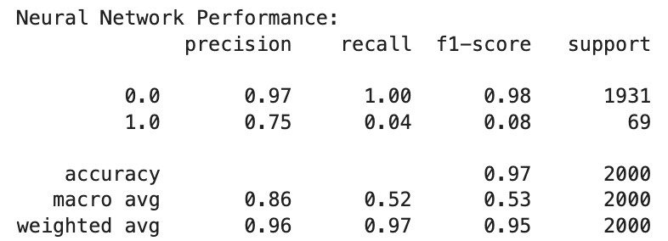
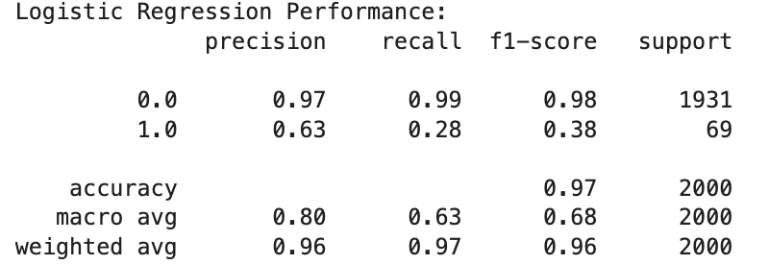
Performance summary
The NN achieves a precision of 0.75 for Class 1.0, outperforming LR's 0.63, which is valuable for reducing
The NN has 100% recall for Class 0.0, ensuring no false negatives, slightly better than LR's 0.99.
Potential for Improvement: The NN can further improve recall for the minority class with different number of neurons, layers and different types of activation functions

Slide 57
Deep Learning

Slide 58
Introduction to Machine Learning Course Roadmap
What is the goal of the data analysis?
Predict an output |  |  |  |  |  | Reveal patterns or relationships |  | Make decisions using an autonomous agent
Supervised Learning (Output in the data set) |  |  |  |  |  | Unsupervised Learning (No output in the data set) |  | Reinforcement Learning* (Supervised & unsupervised)
Continuous or discrete output? |  |  |  |  |  | What is the subgoal? |  | Does a model exist?
Continuous |  |  | Discrete |  |  | Identify groups | Reduce dimensions | Model Based | Model Free
Simple linear regression Multiple linear regression Subset selection Ridge regression & LASSO PCR & PLS | Polynomial regression Step functions Splines Local regression General additive models | Decision tree Random forest Neural network Gradient boosting tree | Logistic regression Linear discriminant analysis Quadratic discriminant analysis | Decision tree Random forest Neural network Gradient boosting tree | Support vector machines | Hierarchical clustering K-means clustering | Principal components analysis | Given the model Learn the model | Policy Optimization Q-Learning
Neural network
Neural network
*Advanced Topic: Bonus module if time
Notes:
Neural networks are a very flexible technique that can be used in supervised learning with both continuous and discrete responses. They can also be used in the unsupervised learning context. This means they can be useful when we have data with outputs that we may want to predict or classify, or when we do not have outputs and simply want to determine patterns and relationships in data.
This module will focus on a conceptual understanding of neural networks in the supervised learning context but the ideas can be extended to the unsupervised learning context.

Slide 59
Now you should be able to:
Describe the general ideas behind neural networks
Describe situations in which neural networks would be useful
Describe the general procedures for Convolution Neural Networks (CNN), Recurrent Neural Networks (RNN), Gradient Descent, Back Propagation, and Dropout Learning
Implement basic neural network Python

Slide 60
Additional exercises
Due to time constraints, we’ll skip the CNN and RNN implementations.
However, the code is fully prepared with detailed comments to make it easy to follow and run the code.

Slide 61
Exercise: CIFAR100 data
Python Code
Load CIFAR-100 training and test datasets, downloading if not already present
(cifar_train, cifar_test) = [CIFAR100(root="data", train=train, download=True) for train in [True, False]]
transform = ToTensor()
cifar_train_X = torch.stack([transform(x) for x in cifar_train.data])
cifar_test_X = torch.stack([transform(x) for x in cifar_test.data])
cifar_train = TensorDataset(cifar_train_X, torch.tensor(cifar_train.targets))
cifar_test = TensorDataset(cifar_test_X, torch.tensor(cifar_test.targets))
Apply the ToTensor transform to each image in the training set and stack them into a tensor
Apply the ToTensor transform to each image in the test set and stack them into a tensor
Create a TensorDataset for the
training and test data with images
and corresponding labels (targets)
.

Slide 62
Exercise: CIFAR100 data
Python Code
Automatically determine the recommended number of workers for data loading based on your system’s resources
max_num_workers = rec_num_workers()
cifar_dm = SimpleDataModule(cifar_train,
cifar_test,
validation=0.2,
num_workers=max_num_workers,
batch_size=128)
Create a data module for CIFAR datasets with
20% validation split, optimal data loading,
and a batch size of 128.

Slide 63
Exercise: CIFAR100 data
Python Code
class BuildingBlock(nn.Module):
def __init__(self, in_channels,out_channels):
super(BuildingBlock , self).__init__()
self.conv = nn.Conv2d(in_channels=in_channels,
out_channels=out_channels,
kernel_size=(3,3),
padding='same’)
self.activation = nn.ReLU()
self.pool = nn.MaxPool2d(kernel_size=(2,2))
def forward(self, x):
return self.pool(self.activation(self.conv(x)))
Define a 2D convolutional layer with
a 3x3 kernel and 'same' padding
Apply ReLU activation function for non-linearity
Define a 2x2 max pooling layer
to reduce spatial dimensions
Apply convolution, ReLU activation,
and max pooling in sequence

Slide 64
Exercise: CIFAR100 data
class CIFARModel(nn.Module):
def __init__(self):
super(CIFARModel, self).__init__()
sizes = [(3,32),
(32,64),
(64,128),
(128,256)]
self.conv = nn.Sequential(*[BuildingBlock(in_, out_) for in_, out_ in sizes])
self.output = nn.Sequential(nn.Dropout(0.5),
nn.Linear(2*2*256, 512),
nn.ReLU(),
nn.Linear(512, 100))
def forward(self, x):
val = self.conv(x)
val = torch.flatten(val, start_dim=1)
return self.output(val)
Python Code
Define the convolutional layer sizes
(input channels, output channels)
for the BuildingBlock
Create a sequential stack of BuildingBlock layers using the sizes defined above
The output layer consists of dropout,
a fully connected layer mapping
2×2x 562 features to 512 neurons
with ReLU activation,
linear layer mapping 512 neurons to 100 classes
Forward pass by processing input through
convolutional blocks and flattening

Slide 65
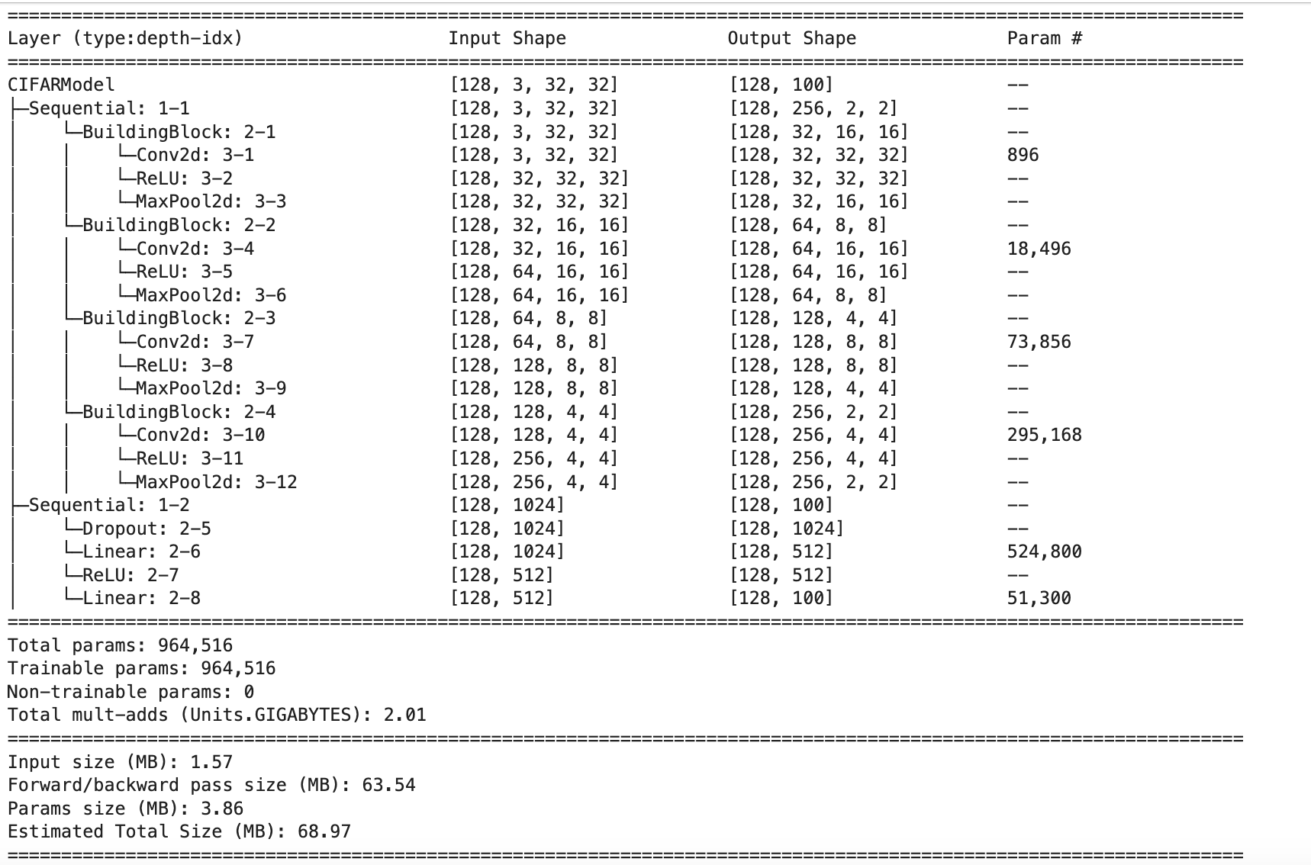
Exercise: CIFAR100 data
Python Code
Initialize the CIFARModel for
image classification
cifar_model = CIFARModel()
summary(cifar_model,
input_data=X_,
col_names=['input_size', 'output_size’, 'num_params'])
Provide the input tensor’s size for
shape calculation and the number of parameters

Slide 66
Exercise: CIFAR100 data
Python Code
cifar_optimizer = RMSprop(cifar_model.parameters(), lr=0.001)
cifar_module = SimpleModule.classification(cifar_model,
num_classes=100,
optimizer=cifar_optimizer)
cifar_logger = CSVLogger('logs', name='CIFAR100')
cifar_trainer = Trainer(deterministic=True,
max_epochs=30,
logger=cifar_logger,
enable_progress_bar=False,
callbacks=[ErrorTracker()])
cifar_trainer.fit(cifar_module,
datamodule=cifar_dm)
Initialize RMSprop optimizer
with a learning rate = 0.001
Wraps cifar_model for classification
with 100 classes and the cifar_optimizer
Initialize a logger to save training logs in a CSV file
Set up the trainer for 30 epochs with reproducibility
Use CSV logging, disable progress bar
Track errors during training
Train ‘cifar_module’ model

Slide 67
Exercise: CIFAR100 data
Python Code
Get the file path of the CSV log file
log_path = cifar_logger.experiment.metrics_file_path
cifar_results = pd.read_csv(log_path)
fig, ax = plt.subplots(1, 1, figsize=(6, 6))
summary_plot(cifar_results,
ax,
col='accuracy',
ylabel='Accuracy')
ax.set_xticks(np.linspace(0, 30, 6).astype(int))
ax.set_ylabel('Accuracy')
ax.set_ylim([0, 1])
Read the training metrics from the CSV file
Plots the accuracy plot using
customized function ‘summary_plot’.
‘summary_plot’ function is in the code file but we will not go through it.

Slide 68
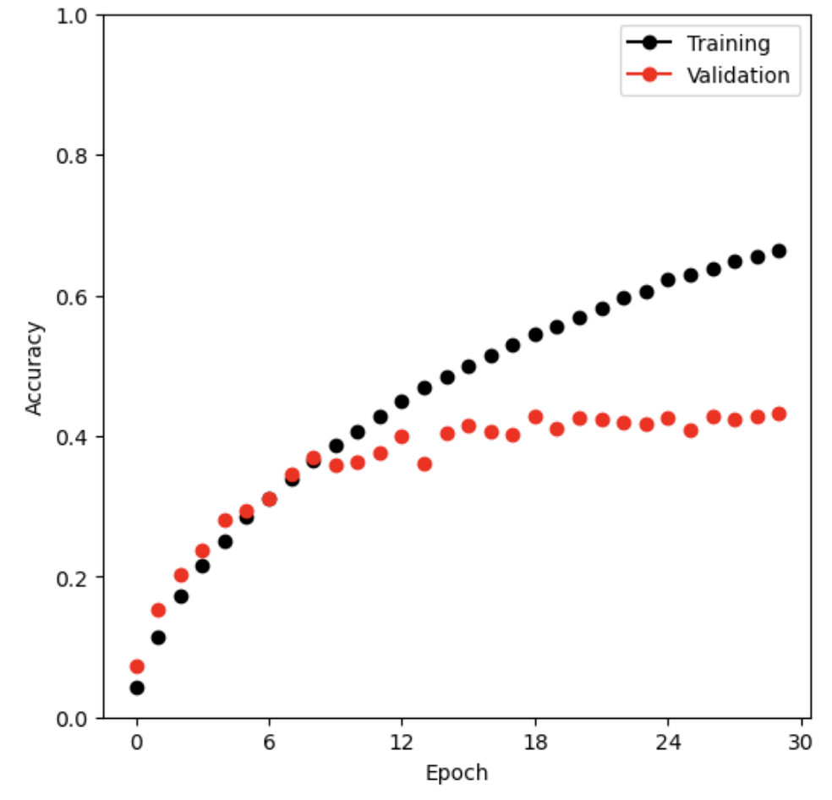
CIFAR100 results
Training accuracy is increasing steadily showing
the model is learning.
Validation accuracy peaks early and remains relatively flat with slight fluctuations, indicating overfitting.
Based on this, improvement can be needed. We can try regularization or reducing model complexity.

Slide 69
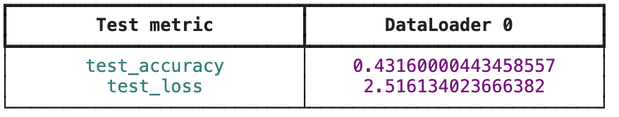
CIFAR100 results
Python Code
Evaluate the trained model on the test dataset
cifar_trainer.test(cifar_module, datamodule=cifar_dm)
By using a different number of neurons, layers and different types of activation functions you can enhance the model's performance. Regularization, hyperparameter tuning also can be a way to improve model performance.

Slide 70
Exercise: IMDB
Python Code
Load sequential imdb data to train and test set
(imdb_seq_train,
imdb_seq_test) = load_sequential(root='data/IMDB')
padded_sample = np.asarray(imdb_seq_train.tensors[0][0])
sample_review = padded_sample[padded_sample > 0][:12]
sample_review[:12]
max_num_workers=10
(imdb_train,
imdb_test) = load_tensor(root='data/IMDB')
imdb_dm = SimpleDataModule(imdb_train,
imdb_test,
validation=2000,
num_workers=min(6, max_num_workers),
batch_size=512)
Convert the first data sample from the training set into a NumPy array
Remove padding and select the first 12 tokens
Load tensor format imdb data to train and test set
Initialize data module
Use 2000 samples from training set for validation Batch size for loading data is 512

Slide 71
Exercise: IMDB
class IMDBModel(nn.Module):
def __init__(self, input_size):
super(IMDBModel, self).__init__()
self.dense1 = nn.Linear(input_size, 16)
self.activation = nn.ReLU()
self.dense2 = nn.Linear(16, 16)
self.output = nn.Linear(16, 1)
def forward(self, x):
val = x
for _map in [self.dense1,
self.activation,
self.dense2,
self.activation,
self.output]:
val = _map(val)
return torch.flatten(val)
Python Code
First layer: input_size -> 16 neurons
Relu activation function
Second layer: 16 neurons -> 16 neurons
Output layer: 16 neurons -> 1 neuron
Start with input data
sequentially applies the layers
and activations to the input val
Flatten the output to be
compatible with loss functions

Slide 72
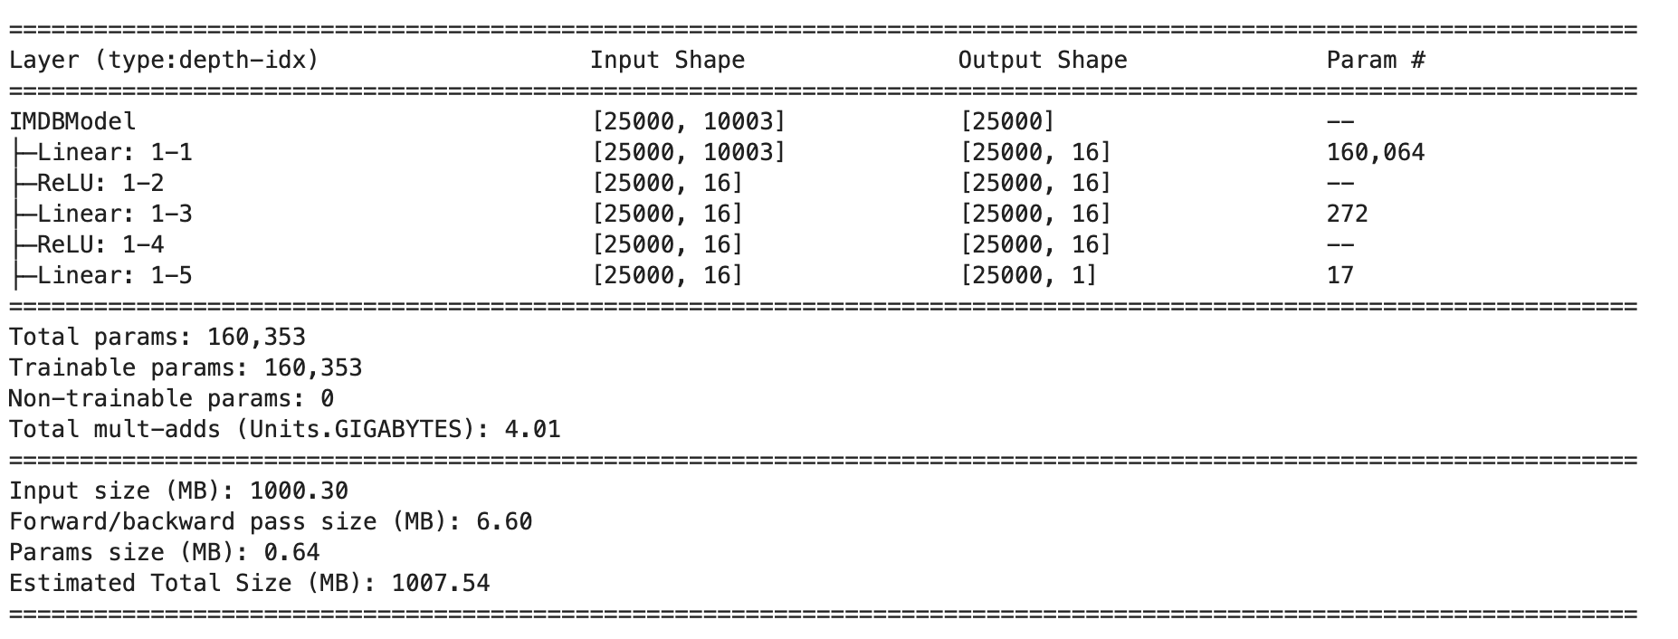
Exercise: IMDB
Python Code
Initialize the IMDBModel with the number of input features
imdb_model = IMDBModel(imdb_test.tensors[0].size()[1])
summary(imdb_model,
input_size=imdb_test.tensors[0].size(),
col_names=['input_size',
'output_size',
'num_params'])
Provide the input tensor’s
size for shape calculation

Slide 73
Exercise: IMDB
Python Code
Initialize RMSprop optimizer with learning rate 0.001
imdb_optimizer = RMSprop(imdb_model.parameters(), lr=0.001)
imdb_module = SimpleModule.binary_classification(
imdb_model,
optimizer=imdb_optimizer)
imdb_logger = CSVLogger('logs', name='IMDB')
imdb_trainer = Trainer(deterministic=True,
max_epochs=30,
logger=imdb_logger,
enable_progress_bar=False,
callbacks=[ErrorTracker()])
Initializes a binary classification module with imdb_model as the underlying model for training, Imdb_optimizer for training and evaluation
Initialize a logger to save training logs in a CSV file
Set up the trainer for 30 epochs with reproducibility
Use CSV logging, disable progress bar
Track errors during training
Notes:
A logger is a tool that records information about the training, validation, and testing processes, such as metrics

Slide 74
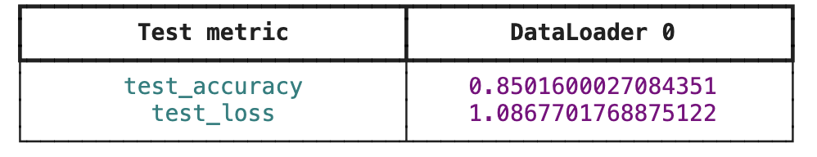
IMDB Results
Python Code
Train the `imdb_module` model
imdb_trainer.fit(imdb_module, datamodule=imdb_dm)
test_results = imdb_trainer.test(imdb_module, datamodule=imdb_dm)
test_results
Evaluate the trained model
on the test dataset
By using a different number of neurons, layers and different types of activation functions
You can enhance the model's performance.

Slide 75
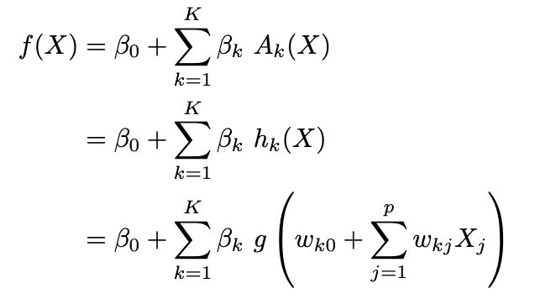
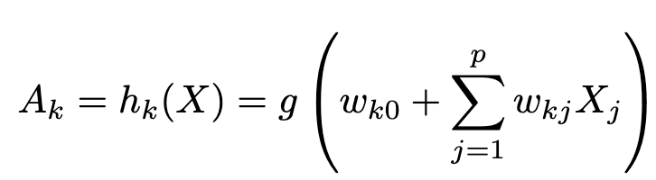
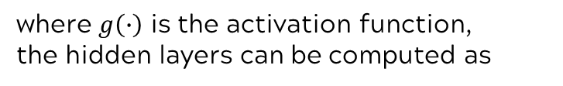
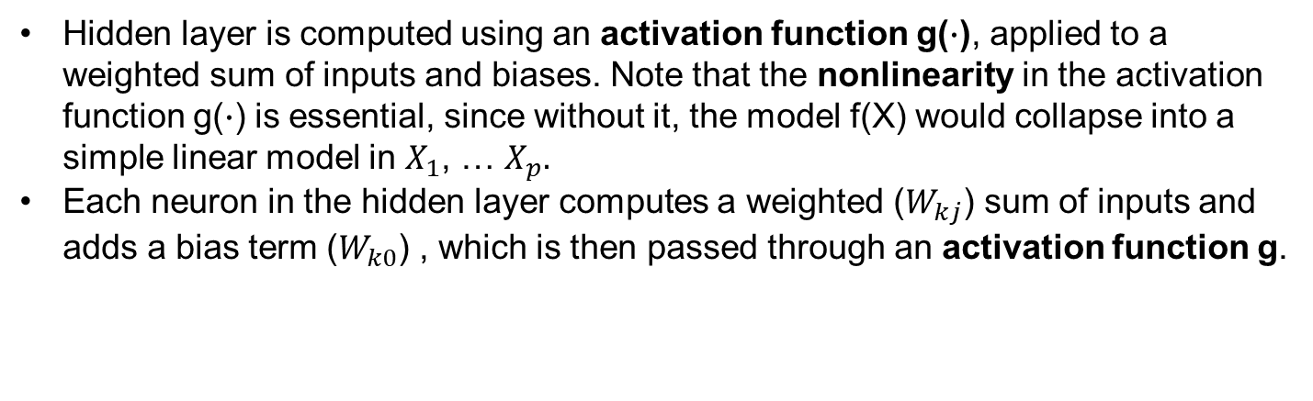
Single layer neural network
where $g\left(∙\right)$ is the activation function,
the hidden layers can be computed as
Hidden layer
Hidden layer is computed using an activation function g($∙$), applied to a weighted sum of inputs and biases. Note that the nonlinearity in the activation function g($∙$) is essential, since without it, the model f(X) would collapse into a simple linear model in $X_{1}$, … $X_{p}.$
Each neuron in the hidden layer computes a weighted ($W_{kj}$) sum of inputs and adds a bias term ($W_{k0}$) , which is then passed through an activation function g.

Slide 76
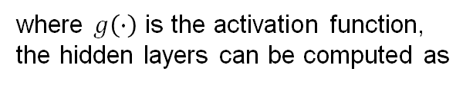
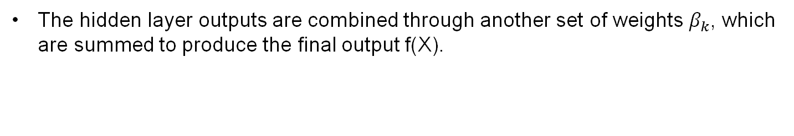
Single layer neural network
where $g\left(∙\right)$ is the activation function,
the hidden layers can be computed as
Weight of
each neurons
The hidden layer outputs are combined through another set of weights $β_{k}$, which are summed to produce the final output f(X).

Slide 77
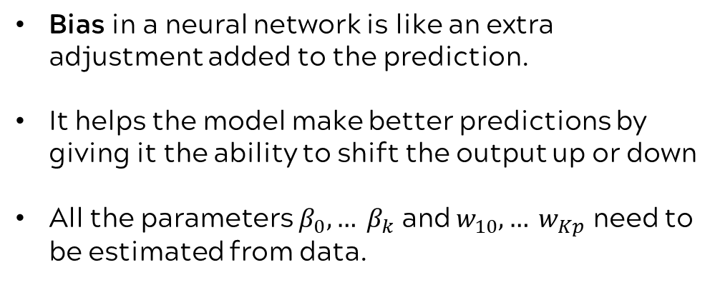
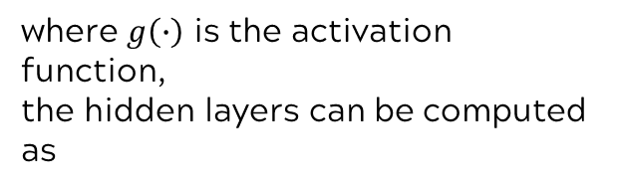
Single layer neural network
where $g\left(∙\right)$ is the activation function,
the hidden layers can be computed as
Bias
Bias in a neural network is like an extra adjustment added to the prediction.
It helps the model make better predictions by giving it the ability to shift the output up or down
All the parameters $β_{0}, … β_{k}$ and $w_{10}, … w_{Kp}$ need to be estimated from data.

Slide 78
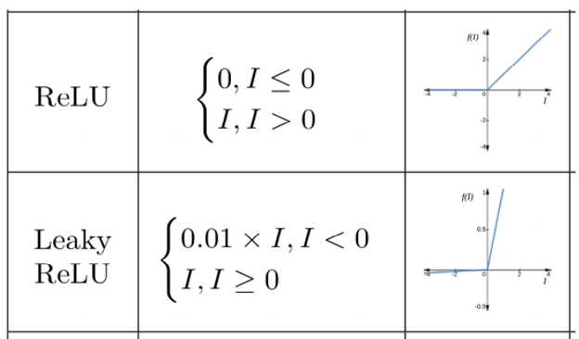
Example of activation function
ReLU is the most widely used activation function in hidden layers due to its simplicity and effectiveness.
ReLU can suffer from the dying ReLU problem, where neurons can become inactive (outputting 0 for all inputs) if the input values are always negative.
Similar to ReLU but with a small positive slope for negative inputs to avoid the dying ReLU problem.

Slide 79
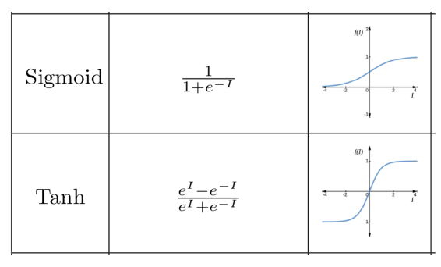
Example of activation function
Commonly used in the output layer for binary classification tasks, where the goal is to predict probabilities between 0 and 1
Can cause vanishing gradients, making it harder for the model to learn during backpropagation. Additionally, outputs are not zero-centered, which can slow down gradient updates.
Often used in hidden layers of neural networks. It is preferred over Sigmoid because it provides zero-centered outputs, which can make optimization easier.
Like Sigmoid, Tanh also suffers from the vanishing gradient problem, which can slow down the learning process in deep networks.

Slide 80
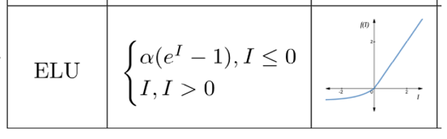
Example of activation function
Used in hidden layers and is similar to Leaky ReLU but introduces smoother and more gradual activation for negative inputs, which can lead to better performance.
More computationally expensive than ReLU and Leaky ReLU because of the exponential function

